Slide 1
CGB1121 – PYTHON PROGRAMMING END SEMESTER PROJECT REVIEW – APRIL/MAY 2026
Department of Computer Science and Engineering
Academic Year: 2025 – 2026 (Even Semester)
Batch No. :24
Register Number :927625BCS012, 927625BCS038
Name :ANUSIYA S, EMIMA JENEFAR S
Year : I
Semester : II
Section : A
Date : 04/06/2026

Slide 2
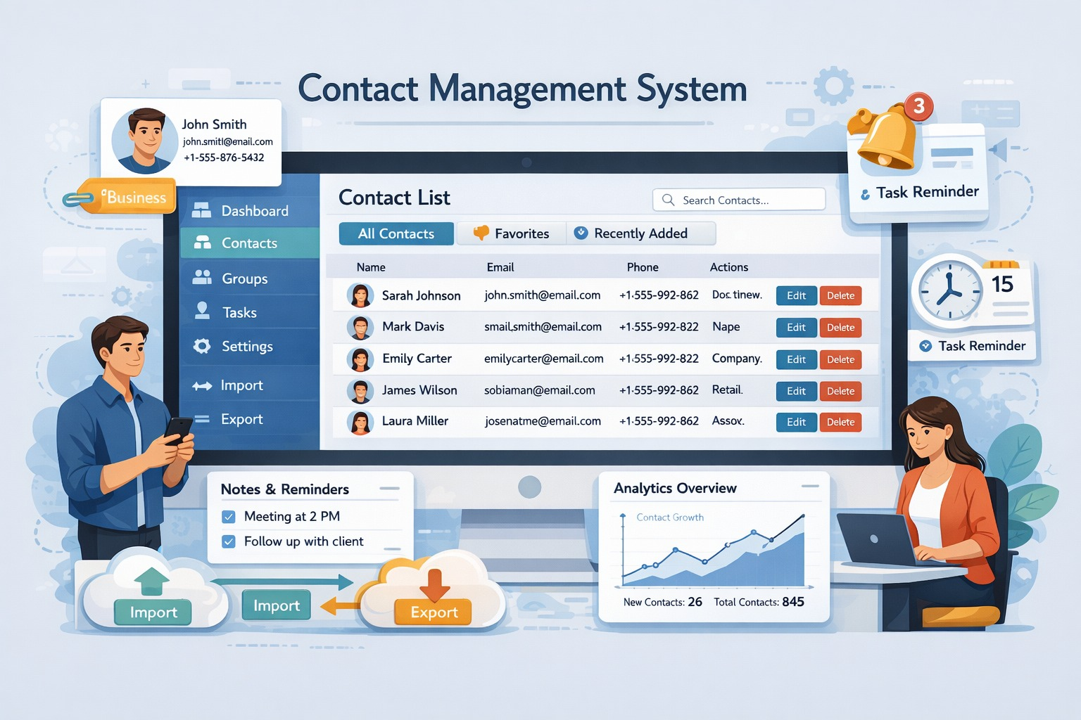
Title of the Project
CONTACT MANAGEMENT SYSTEM

Slide 3
Abstract
A Contact Management System is an application designed to store, organize, and manage contact information efficiently. In this project, a Contact Management System is developed using the Python programming language with a graphical user interface (GUI). The system allows users to add, view, update, and delete contact details such as first name, last name, phone number, and email address. The application uses Python libraries to ensure easy interaction and reliable data storage. This project demonstrates the application of Python fundamentals, control structures, functions, and modern tools to solve a real-world data management problem. The developed system reduces manual effort, improves accuracy, and provides a user-friendly platform for managing contacts effectively.

Slide 4
Abstract with CO/PO Mapping
Abstract | CO | POs | PSO
A Contact Management System is an application designed to store, organize, and manage contact information efficiently. In this project, a Contact Management System is developed using the Python programming language with a graphical user interface (GUI). The system allows users to add, view, update, and delete contact details such as first name, last name, phone number, and email address. The application uses Python libraries to ensure easy interaction and reliable data storage. This project demonstrates the application of Python fundamentals, control structures, functions, and modern tools to solve a real-world data management problem. The developed system reduces manual effort, improves accuracy, and provides a user-friendly platform for managing contacts effectively. | CO1 CO2 CO3 CO5 | PO1(2) PO2(3)PO3(2) PO5(2) PO7(1) PO8(2) PO9(2) PO10(1) PO11(3) PO12(3) | PSO1 PSO2

Slide 5
Introduction
In today’s digital world, managing contact information manually is inefficient and error-prone. With the increasing number of personal and professional contacts, there is a need for an organized and computerized system to store and retrieve contact details easily. A Contact Management System helps users maintain contact information in a structured and secure manner. This project focuses on developing a Contact Management System using Python. The system provides basic operations such as adding new contacts, viewing existing contacts, updating contact details, and deleting unwanted records. A graphical user interface is designed to make the application simple and easy to use for users with minimal technical knowledge. The project highlights the practical use of Python programming concepts and libraries in developing a real-time application, thereby enhancing problem-solving skills and application development knowledge.

Slide 6
Python Programming - Concepts Used
1.Python fundamentals
Variables and data types
Basic Python syntax
Input handling through GUI
2. Control Statements and Functions
User-defined functions (add, update, delete)
Conditional statements (if, else)
3. Strings, Lists, and Tuples
Strings for names, phone, email
Lists for displaying contacts
Tuples for database records
4. Python Libraries and Application Development
Tkinter for GUI
SQLite (sqlite3) for database
Message box for alerts

Slide 7
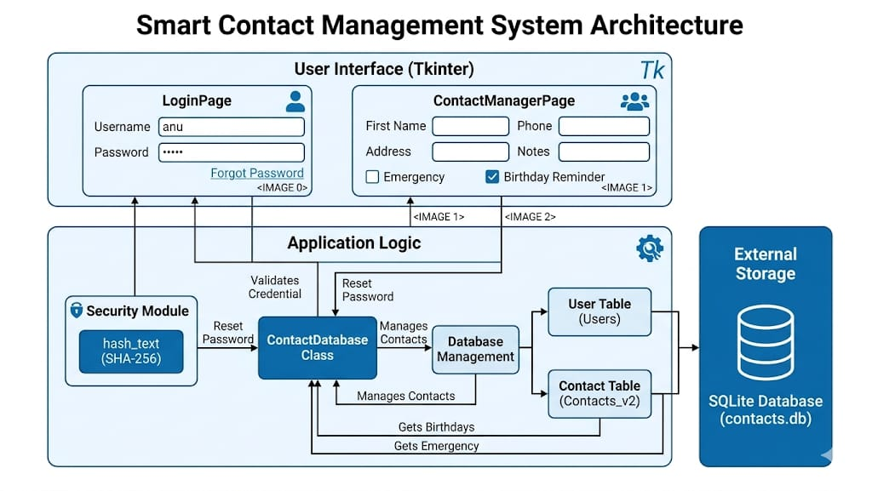
Proposed Architecture

Slide 8
Proposed Architecture - Description
1. Presentation Layer (Tkinter UI)
Login Page: Handles user authentication and access to the "Forgot Password" dialog.
Contact Manager Page: The main dashboard for viewing the contact list (Treeview), adding new entries, and managing updates or deletions.
2. Application Logic Layer (Python)
Security Module: Implements SHA-256 hashing via hash_text to securely validate credentials and reset passwords.
Contact Database Class: The core engine that bridges the UI and storage. It manages SQL query execution, automated table migrations, and data logic like birthday reminders.
3. Data Layer (SQLite)
contacts.db: The physical database file.
Users Table: Stores username, password_hash, and security_answer_hash.
Contacts_v2 Table: Stores detailed contact information including phone, email, LinkedIn/GitHub IDs, and emergency status.

Slide 9
List of Modules
Login Module
Contact Management Module
Search Module
Reminder Module
Database Module

Slide 10
Description of Modules
1. Login Module
This module verifies user credentials for secure access. It also provides a password reset option using a security answer.
2. Contact Management Module
This module allows adding, updating, and deleting contact details. It ensures proper validation of essential fields like name and phone number.
3. Search Module
This module enables users to search contacts using keywords. It quickly displays matching results for easy access.
4. Reminder Module
This module shows upcoming birthday reminders for contacts. It helps users remember important dates.
5. Database Module
This module manages data storage using SQLite. It performs all database operations like insert, update, delete, and retrieve.

Slide 11
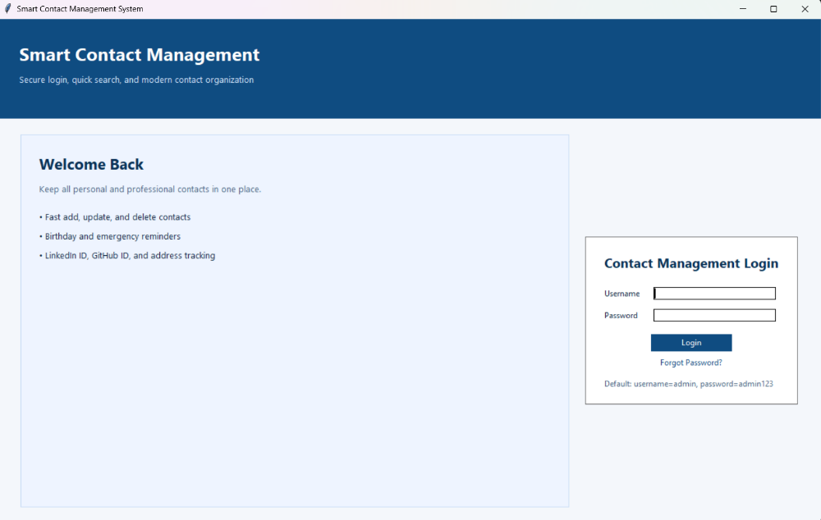
Results and Discussion
Output Screenshot:
Description:
This screen serves as the secure gateway to the system, featuring a modern branded header and a credential input panel with a "Forgot Password" recovery option.

Slide 12
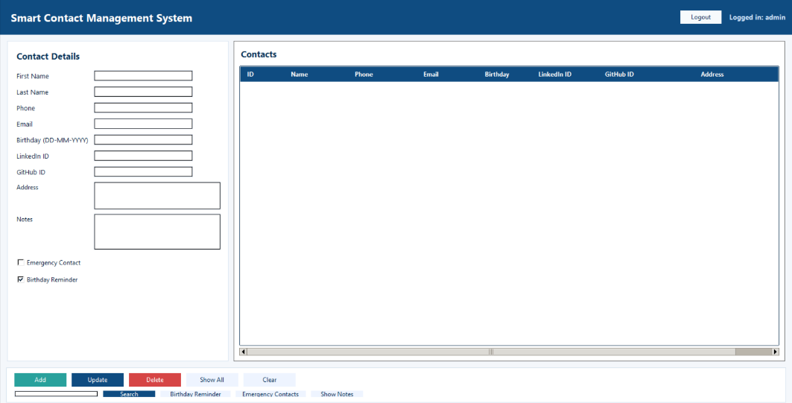
Results and Discussion(Cont..)
Output Screenshot:
Description:
This is the primary management hub where users can input detailed contact information, such as social IDs and reminders, into a structured, wide-screen data grid.

Slide 13
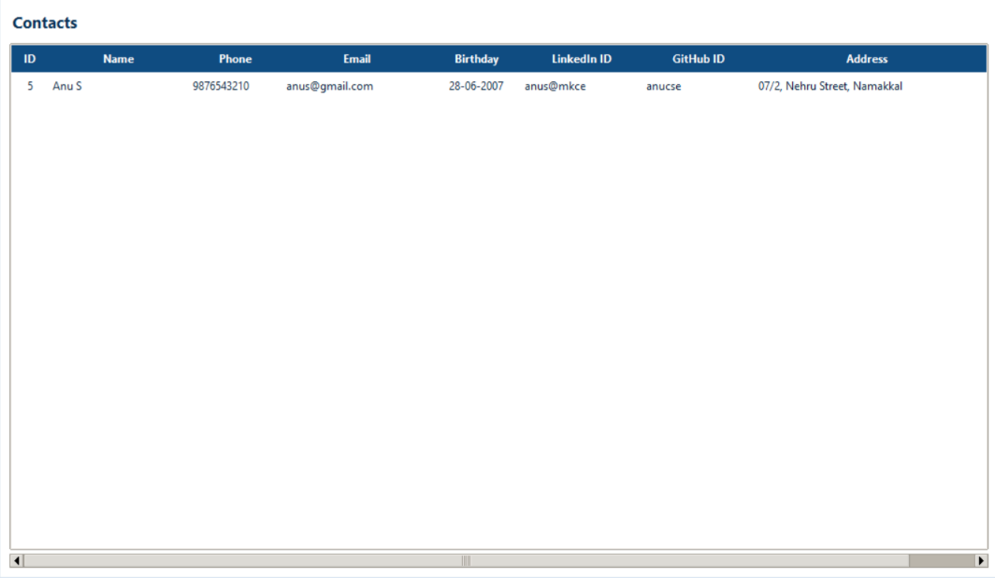
Results and Discussion(Cont..)
Output Screenshot:
Description:
This view demonstrates the successful retrieval of data from the SQLite database, displaying saved contact records like "Anu S" in a clean, professional table format.

Slide 14
Conclusion
The Contact Management System developed using Python successfully provides an efficient solution for storing and managing contact details digitally. The project demonstrates the effective use of Python programming concepts, GUI development with Tkinter, and database management using SQLite. Through this system, users can easily add, view, update, and delete contacts in a secure and organized manner. The application improves data accessibility, reduces manual record maintenance, and enhances user convenience through a simple graphical interface. The project also helps in understanding real-world application development by integrating programming logic, user interaction, and database operations into a single system. Overall, the Contact Management System is reliable, easy to maintain, and can be further enhanced with additional features such as search functionality, password protection, cloud storage, and mobile support in future developments.

Slide 15
Thank You
Any queries???

